Slide 1

Three-Schema Architecture
of DBMS
An overview of the ANSI/SPARC Database Architecture

Slide 2

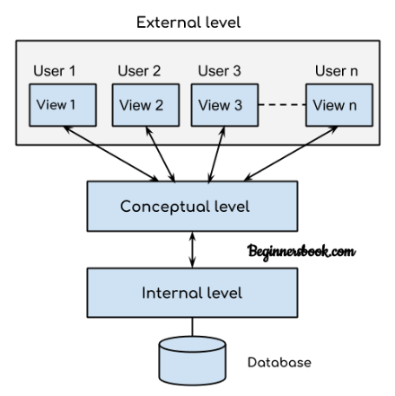
What is the Three-Schema Architecture?
Definition: Also known as the ANSI/SPARC Architecture, it is a framework that separates the database into three distinct levels.
Primary Goal: To provide robust data abstraction and data independence.
Versatility: Allows multiple users to view and interact with the exact same database in completely different ways.
Security: By separating views, it ensures users only see the data they are authorized to access.

Slide 3
Visualizing the Architecture
The architecture relies on structured mappings between three core layers:
External Level: The top layer, defining various individual user views.
External-Conceptual Mapping: Translates user views into logical structures.
Conceptual Level: The middle layer, defining the database's global logical structure.
Conceptual-Internal Mapping: Translates logical constructs into physical storage parameters.
Internal Level: The bottom layer, dictating actual physical storage on the hardware.

Slide 4









The Three Levels at a Glance
1. External Level
2. Conceptual Level
3. Internal Level
The highest level of abstraction. Focuses on individual user views and hides the rest of the database.
The logical blueprint. Defines tables, relationships, and constraints for the entire database globally.
The lowest physical level. Dictates exactly how data is encoded and stored on the hard drives.

Slide 5
1. External Level (View Level)
Highest Abstraction: Represents the highest level of abstraction in the DBMS.
User-Centric: Describes only the specific part of the database that a particular user is permitted to access.
Multiple Views: Different users can have entirely different, customized views of the same underlying database.
Complexity Hidden: Completely hides all complex logical and physical database details from the end-user.
Example: The HR department sees employee personal details, while the Accounts department only sees salary details.

Slide 6
2. Conceptual Level (Logical Level)
Global View: Represents the complete logical structure of the entire database for a community of users.
Schema Definition: Explicitly defines entities, relationships, constraints, and data types.
Physical Independence: Completely hides physical storage structures and access details from the users above it.
DBA Domain: This level is primarily managed and maintained by the Database Administrator (DBA).

Slide 7
3. Internal Level (Physical Level)
Lowest Abstraction: The lowest level of abstraction before hitting actual hardware.
Storage Details: Describes precisely how data is actually stored on physical storage devices (like HDDs/SSDs).
Technical Scope: Includes complex parameters like file organization, data compression, encryption, indexing, and storage allocation.
Optimization Focus: Primarily focuses on performance tuning and highly efficient data storage/retrieval methods.

Slide 8
Advantages of Three-Schema Architecture
Improves Security: Enhances security by restricting user views to only authorized data components.
Provides Data Independence: Changes in lower levels (e.g., hardware upgrades) do not affect higher-level user applications.
Supports Multiple Views: Effortlessly supports multiple different user perspectives of the same centralized data.
Simplifies Management: Centralizes the logical blueprint, simplifying overall database administration and maintenance.

Slide 9
Conclusion
The Three-Schema Architecture intelligently divides a database into External, Conceptual, and Internal levels. This clear separation guarantees robust data abstraction, strict security, and critical data independence, ultimately making modern database systems significantly easier to build, manage, and scale.

